Slide 1

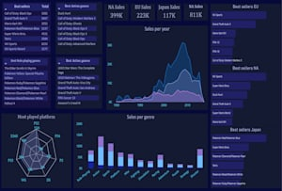
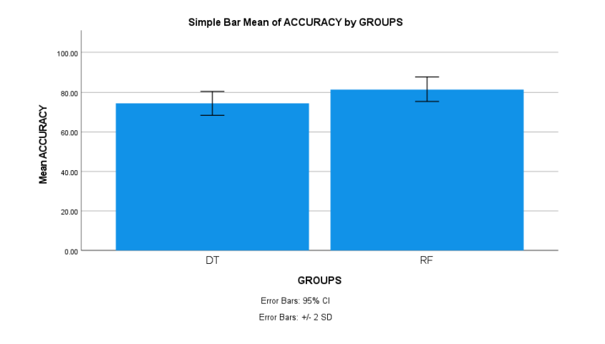
Name: Mr. Jonnalagadda Sai Chandu Register Number: 192211216
Guided by K.V. Kanimozhi
Ms. Poorani.S
Guided by Dr. Mary Valantina. G
Efficient Prediction of Sales in Video Games using Random Forest Algorithm in Comparison with Decision Tree Algorithm to Improve Accuracy
INTRODUCTION
This analysis aims to enhance the accuracy of sales predictions in the video game industry by comparing the Random Forest algorithm with Decision Tree algorithm
Lack of accuracy is the main problem in video game sales predictions. This may leads to significant challenges like customers disappointment, uncertainty in investment decisions and financial instability
Machine learning algorithms like DT and RF gives accurate predictions in video games sales. This study suggests a direct comparison between the Random Forest algorithm and the Decision Tree algorithm
The Decision Tree Algorithm is a supervised learning method used for classification and regression tasks. It operates by recursively partitioning the input space into smaller regions based on the features of the data
Random Forest Algorithm builds multiple decision trees and combines their predictions to improve accuracy and reduce overfitting. It operates by aggregating the results of multiple decision trees
Fig.1 Video games sales prediction
MATERIALS AND METHODS
Sample Size: 20
Group-1 (Random Forest): 10 samples
Group-2 (Decision Tree): 10 samples
The samples are tested in SPSS statistical analysis and outputs have been derived
The statistical features extracted are count of samples, mean, standard deviation, minimum and maximum
Non-number data is converted into numerical data for comparison between two algorithms in the dataset
Data Collection
Data
Pre-processing
Splitting data into training data and testing data
Models training (random forest & decision tree)
Performance comparison of Random Forest algorithm with Decision Tree for video games sales
Models validation
Fig.2 Flow Chart for Video game Sales Prediction using algorithm like RF and the DT
RESULTS
Table.1 Group Statistics for Random Forest and Decision Tree Algorithms which contains mean, Standard deviation and the standard deviation Error
Groups |  | N | Mean | Standard deviation | Standard deviation error
Accuracy rate | RF | 10 | 86.40 | 3.027 | 0.957
 | DT | 10 | 79.32 | 3.027 | 0.952
In the present work, Random Forest Algorithm is compared with DT algorithm and it depicts that the Random Forest algorithm gives more accuracy than the Decision Tree
A Random Forest model attained 86.40% accuracy, on the other hand Decision Tree Algorithm attained an accuracy of 79.32%
Fig.3 Mean Accuracy Analysis of DT and RF
DISCUSSION AND CONCLUSION
Based on t-test Statistical analysis, the significance value of p=0.001 (independent sample t-test p<0.05) is obtained and shows that there is a statistical significant difference between the Random Forest and Decision Tree. The accuracy values of two Algorithms: Random Forest Algorithm(RF) - 86.40% Decision Tree(DT) – 79.32%
From the work , it is concluded that the Random Forest algorithm attains the high accuracy when comparing with other Machine Learning Algorithms in video games sales
Further exploration could involve extending the comparison to include other machine learning algorithms or ensemble methods to optimize sales prediction models for diverse gaming genres and platforms
Additionally, integrating real-time data streams from social media could enhance the predictive capabilities, offering deeper insights into consumer behavior and preferences in the ever-evolving gaming landscape
This comparative study sheds light on the efficiency of Random Forest and Decision Tree algorithms in refining sales predictions within the video game industry
BIBLIOGRAPHY
TD, Gowri, and Peter Jose. "Data Interpretation and Video Games Sales Prediction Using Machine Learning Algorithms-a Comparative Study." (2023). DOI: 10.2139/ssrn.4382007
Reddy, P. Pavan, and B. Arthi. "Prediction of Sales in Recognition for Business Purposes using Machine Learning Tool." Turkish Online Journal of Qualitative Inquiry 12, no. 3 (2021). DOI: 10.1109/ISKE54062.2021.9755343
Etchells, Peter J., Alexandra L. Morgan, and Daniel S. Quintana. 2022. “Loot Box Spending Is Associated with Problem Gambling but Not Mental Wellbeing.” Royal Society Open Science 9 (8): 220111. DOI: 10.1098/rsos.220111
Babb, Jeffry, and Neil Terry. "Comparing video game sales by gaming platform." Southwestern Economic Review 40 (2023): 25-46. DOI: 10.1109/CIG.2018.8490456
Islam, Md Irteja, Raaj Kishore Biswas, and Rasheda Khanam. 2021. “Effect of Internet Use and Electronic Game-Play on Academic Performance of Australian Children.” Scientific Reports 10 (1): 21727. DOI:10.1109/ISKE54062.2021.9755343

